Slide 1

Stop The Doxx!
Anti-Doxxing and YOU!
Digital Activism and Antifascism
3/24/18

Slide 2
Who are we? Who are you?
We are the…
The Cypurr Collective: A group of folks that organize cybersecurity workshops and socials, looking to spread knowledge and talk about privacy rights!
...and you are?
Name
Pronouns (i.e. he/him, she/her, they/them, ze/zer, etc)
In a few words, what brings you here today?

Slide 3

A few rules for this workshop …
Share the space!
Step Up Step Back: Ask a question, give a comment, leave room for others to speak
Stack!
Raise your hand and we will put you on the speaking queue
Saf(er) Space
We DO NOT tolerate language or behavior purposefully meant to demean or harm folks based on their identities
No one should be forced to discuss their own experience/threat model/situation
Consent: Ask before helping someone out, before taking their device
Photo/Video- No photo/video without asking!
Bonus Rule: Try not to invalidate experiences!

Slide 4

Doxxing &
Cyber Harassment

Slide 5
Some Definitions...
Cyberbullying/Cyber Harassment
“bullying that takes place over digital devices like cell phones, computers, and tablets. Cyberbullying can occur through SMS, Text, and apps, or online in social media, forums, or gaming where people can view, participate in, or share content.”
Doxxing
“a technique of tracing someone or gather information about an individual using sources on the internet. Its name is derived from “Documents” or “Docx”. Doxing method is based purely on the ability of the hacker to recognize valuable information about his target and use this information to his benefit.”
Notes:
Flaming: This is an aggressive exchange between two or more people online.
Impersonation: Technology allows people to post or comment as others if they have gained access to another’s account. This can be used to bully.
Cyber Stalking: Social media and messaging gives stalkers new opportunities to contact follow and harass their victims.
Outing: Direct access to large groups of people can make outing, sharing secrets and other personal information all the more hurtful.
Trolling: This involves trying to wind up others online with immature questions or mean comments.

Slide 6

Context
“Doxing is not new; the term dates back to 2001 and the hacker group Anonymous. But it can be incredibly offensive. In 2014, several women were doxed by male gamers trying to intimidate them into keeping silent about sexism in computer games.
Companies can be doxed, too. In 2011, Anonymous doxed the technology firm HBGary Federal. In the past few weeks we've witnessed the ongoing doxing of Sony.”
-Bruce Schneier
Notes:
Anonymity: These bullies often cruise the Internet under pseudonyms, often the victim often does not know who is doing the bullying.
Accessibility: The cyber bully can approach his victim at any time over the Internet. Since the contact is not physical or face-to-face there is no specific time during which the bully has access.
Punitive Fears: Victims often fear retaliation from their tormentors. If the victim is a child, the fear of losing access to a computer or other technology may prevent them from seeking help or reporting the behaviour.
Disinhibition: The anonymity of the Internet can encourage an individual to commit acts they might not otherwise attempt in person. It affords false courage when the bully thinks he can’t be identified.
40% of Adult Online Users experienced- Ad Week

Slide 7

Sources/Targets of Doxxing
Looking for...
Name
Address
Profiles
Images
Passwords
Forms of Contact
Phone
Email
Sources
Social Media
Data Broker Sites
Search Engines
Public Records
Email
Phishing
WHOIS

Slide 8








Typical phishing attack path
Information
Gathering
Pretexts
Email
Notes:
Focus on phishing, but process similar for the 3
<number>

Slide 9










Information gathering
Notes:
Human element, we like to share
From social point of view social networks are good
From security point of view not that much
<number>

Slide 10
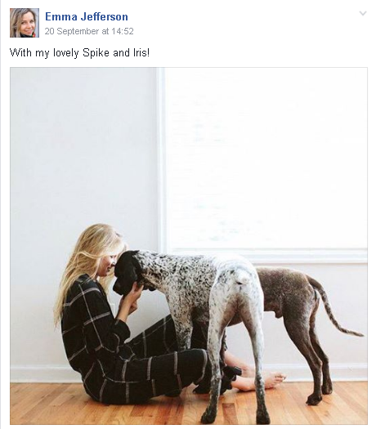
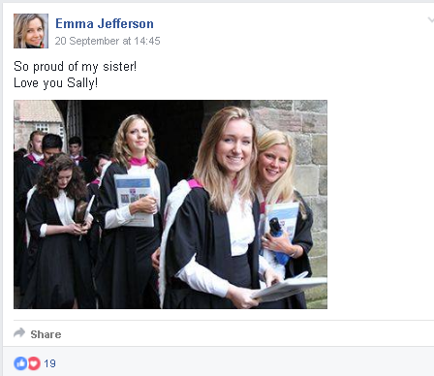
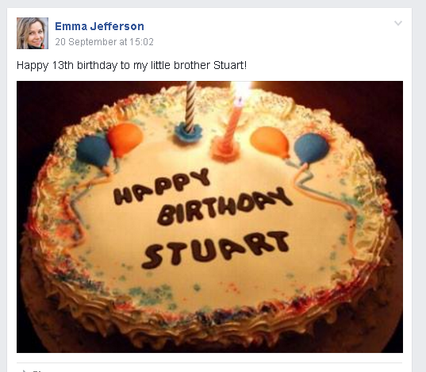
Information gathering
Facebook (Timeline)
Notes:
- Example of password reset functionality, they ask you for stuff like this
<number>

Slide 11
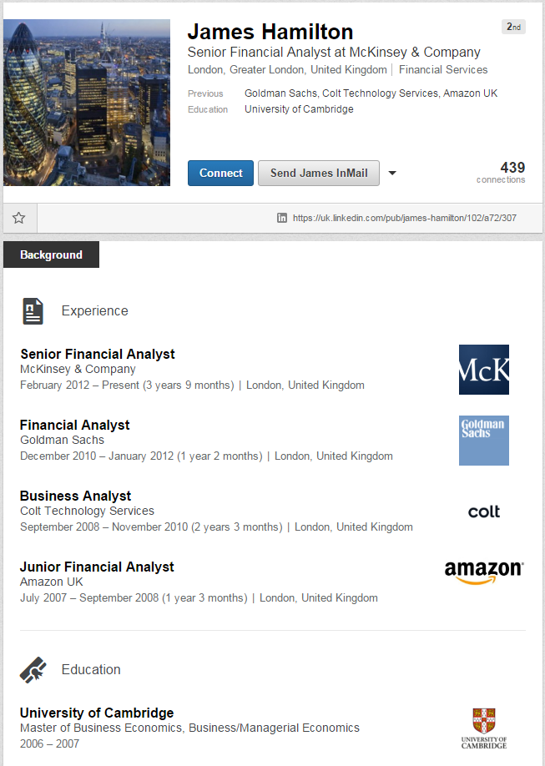
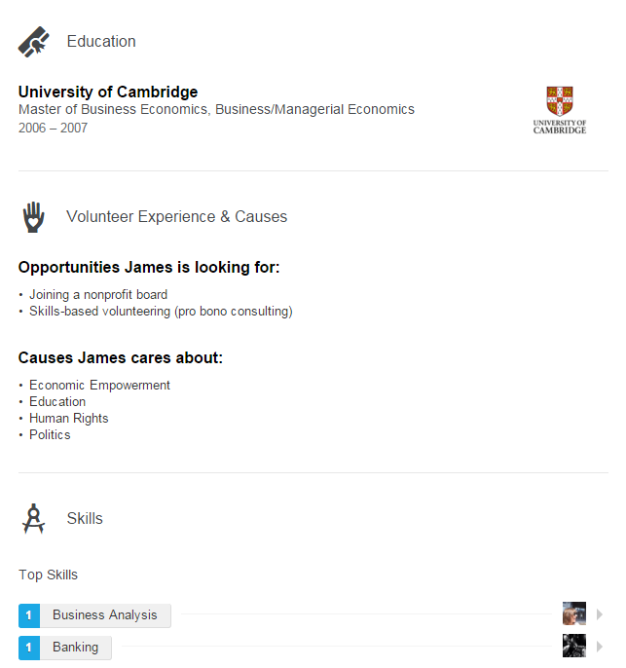
Information gathering
Notes:
Typical LinkedIn profile
<number>

Slide 12
Information gathering
Notes:
Typical LinkedIn profile
<number>

Slide 13
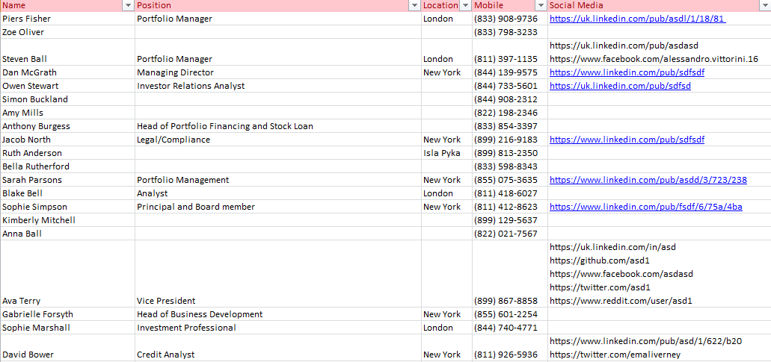
Targets
Notes:
The same thing can be repeated for all targets
<number>

Slide 14
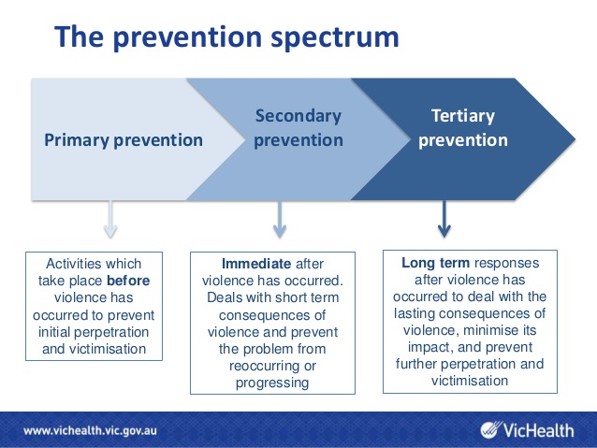

Slide 15

Ways To Reduce Harm Before (Primary Intervention)
Make A Plan (Threat Model)
Who Can Help Me?
What Can I Do?
Protect Passwords
Complicated Passwords
Password Managers
2FA
Twofactorauth.org
Phone Settings
GPS Location
Blocking
Private Browsing
Incognito Mode
Clear Cookies

Slide 16
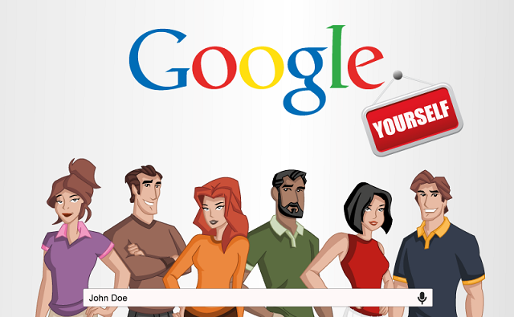
Ways To Reduce Harm Before (Primary Intervention)
Secure Social Media
FB, Twitter, Insta Privacy Settings
Back Up Data
Google Yourself!
Data Brokers
Privacy Duck
WHOIS
Own A website?

Slide 17

Ways To Reduce Harm After (Tertiary Intervention)
Primary Intervention Tactics
Crisis Helpline
Crash Override
HeartMob
Privacy Duck
Report It
Collect Evidence
Change Passwords
Phone
Use Alternative Apps
Change Number?
Reinstall Phone

Slide 18
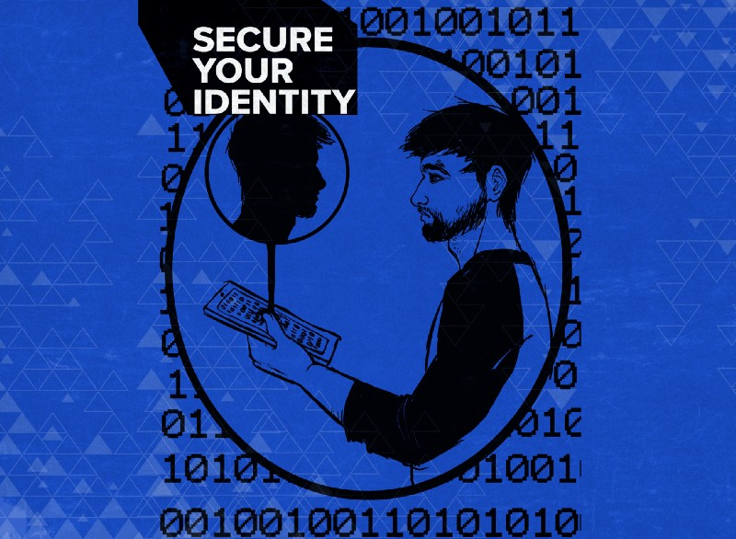
Harm Reduction Re: Doxxing
Tips from Equality Labs
Create Self-Care Plan
Create Incident Log
Change Passwords, Password Managers, 2FA
Call credit card company, utilities, and bank if financially targeted
Change Privacy Settings on Social Media
Delete old, unused accounts
Use aliases
Get to know secure apps/methods of surfing
VPN
Tor
Signal
Protonmail

Slide 19
Resources
HackBlossom- https://hackblossom.org/domestic-violence/
Crash Override Network- http://www.crashoverridenetwork.com/
HeartMob- https://iheartmob.org/
Privacy Duck- https://www.privacyduck.com/
Without My Consent
Resist.Space- https://resist.space/
Equality Labs Anti-Doxxing Guide on Medium https://medium.com/@EqualityLabs/anti-doxing-guide-for-activists-facing-attacks-from-the-alt-right-ec6c290f543c
Other
Tactical Tech Collective- Holistic Security, Data Detox, My Shadow
Cypurr Collective- https://github.com/CyPurr-Collective/, Facebook
Cryptoparty.in

Slide 20


Slide 21

THANK YOU!
THANK YOU!!

